Slide 1
Heart Disease Risk Prediction using Explainable AI
Performance evaluation and explainability of machine learning models for heart disease prediction
Renusree Kakarla
MSc Data Science • University of Hertfordshire
Supervisor: Klaas wiersema

Slide 2
INTRODUCTION
Heart disease is one of the leading causes of death worldwide. Machine learning models can assist in early risk prediction; however, many high-performing models lack interpretability, which limits their adoption in clinical settings. This project aims to compare multiple machine learning models for heart disease prediction while evaluating their explainability using model-agnostic interpretation techniques. Early detection is crucial, and machine learning provides an opportunity to support clinical decision-making through data-driven predictions.
303
Data Entries
14
Data Columns
Research Question:
How do different machine learning models compare in predictive performance for heart disease risk prediction using the UCI Heart Disease dataset?
93.52%
Best Accuracy(Random Forest)

Slide 3
Previous Works
Dubey A.K. et al.(2021)
Predicting Heart Disease Based on Influential Features with Machine Learning .
Karthick K., et al.(2022)
Implementation of a heart disease risk prediction model using machine learning. Comput. Math.
Methods
Ahmad G.N.,et al.(2022)
Mixed machine learning approach for efficient prediction of human heart disease by identifying the
numerical and categorical features.

Slide 4
Novelty & Approach
Previous Approaches
This Project
Support Vector Machine (SVM)
K-Nearest Neighbours (KNN)
Decision Trees
Gradient Boosting
Focus mainly on Accuracy
Limited use of explainability
Logistic Regression (baseline)
Random Forest (ensemble)
XGBoost (advanced boosting Model)
Hyperparameter Tuning
Robust Evaluation
SHAP explainability

Slide 5
DATASET
Data Columns (14):
Age,sex,cp,trestbps,chol,fbs,restecg,thalach,exang,oldpeak,slope,ca,thal,target
Target Variable:
In the original dataset, the target variable ranges from 0 to 4. For binary classification, the target is converted into:
0: No heart disease
1: Presence of heart disease
This transformation is consistent with existing literature.

Slide 6
Ethical Implications
Data Privacy and Anonymity
The dataset is fully anonymized, ensuring that individual patients cannot be identified. This aligns with ethical guidelines for handling healthcare data.
Clinical Responsibility
The model developed in this project is intended for research purposes only and should not be used as a standalone diagnostic tool. Clinical decisions must always involve qualified healthcare professionals.
Limitations and Misuse
Due to the relatively small dataset, the model may not generalise well to broader populations. Misuse of such models without proper validation could lead to incorrect medical conclusions.

Slide 7
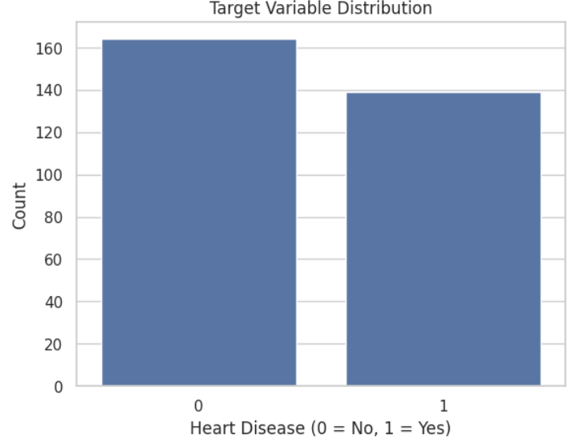
Exploratory Data Analysis
Target Variable Distribution
Key Findings
Checked for missing values and data consistency
Analysed feature distributions
Examined correlations between variables
Confirmed balanced target variable distribution

Slide 8

Data Preprocessing
Missing values were identified and removed.
Dataset split into training and testing sets (80/20).
Feature scaling applied to numerical variables.
Scaling applied where required for model performance.

Slide 9
Machine Learning Models
Logistic Regression was used as a baseline model for comparison.
Random Forest was applied as an ensemble learning method to capture non-linear relationships.
XGBoost was used as a boosting model to improve predictive performance.
All models were trained on the training dataset and evaluated using the test set.
Model performance was compared using accuracy and ROC-AUC metrics.

Slide 10
Model Evaluation
Performance evaluated using:
Accuracy
ROC-AUC score
ROC curves used to compare model performance
Confusion matrices used to analyse predictions

Slide 11
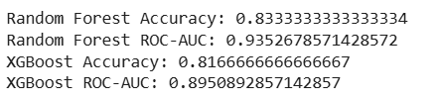
Hyperparameter Tuning
GridSearchCV used for optimisation
Parameters tuned for Random Forest and XGBoost
Improved model generalisation and performance
Selected best-performing parameter combinations

Slide 12
Best Model Selection
Random Forest achieved the highest ROC-AUC score
Captures complex non-linear relationships in data
Selected as the final model for explainability analysis
Explainable AI (SHAP)
SHAP used to interpret model predictions
Identifies contribution of each feature to predictions
Provides global and local explanations
Enhances transparency and trust in the model

Slide 13
Key Findings
Chest pain type is a significant predictor
Maximum heart rate strongly influences predictions
Model results align with medical domain knowledge
Future Work
Use larger and more diverse datasets
Explore additional machine learning and deep learning models
Improve model generalisation
Deploy model in a real-world clinical environment

Slide 14
Conclusion
Machine learning models can effectively predict heart disease
Random Forest outperformed other models in this study
Explainable AI improves interpretability of predictions
The approach supports clinical decision-making research

Slide 15
References
Veisi H., Ghaedsharaf H.R., Ebrahimi M. Improving the Performance of Machine Learning Algorithms for Heart Disease Diagnosis by Optimizing Data and Features. Soft Comput. J. 2021.
Sarra R.R., Dinar A.M., Mohammed M.A., Abdulkareem K.H. Enhanced heart disease prediction based on machine learning and χ2 statistical optimal feature selection model. Designs. 2022 .
Karthick K., Aruna S.K., Samikannu R., Kuppusamy R., Teekaraman Y., Thelkar A.R. Implementation of a heart disease risk prediction model using machine learning. Comput. Math. Methods Med. 2022 .

